Slide 1
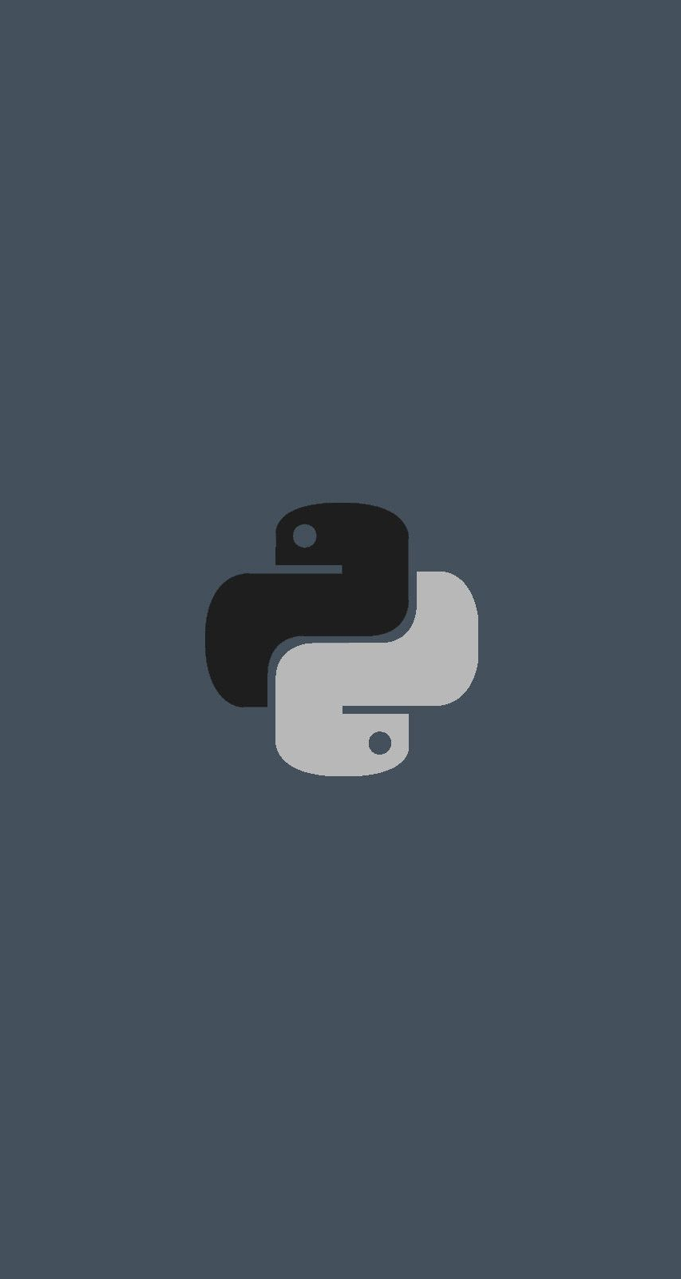
Python Introduction
Thursday, 10 March 2024
Mayank Aggarwal

Slide 2
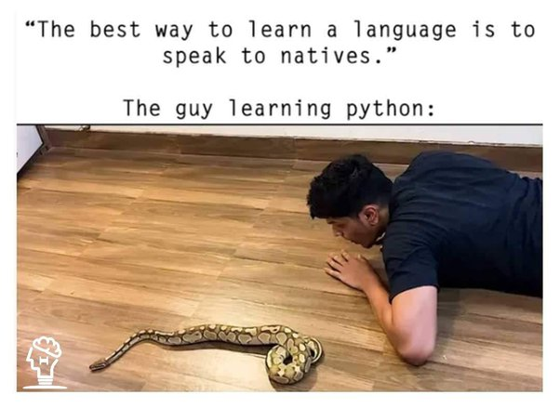

Slide 3
Today’s Agenda
An Introduction to Python
Necessity Of Programming
What Is Python ?
Why And Who Created It ?
What Python Can Do ?
Why Should I Learn Python In 2018 ?
Important Features

Slide 4
Why Do We Need Programming ?
To communicate with digital machines and make them work accordingly
Today in the programming world , we have more than 800 languages available.
And every language is designed to fulfill a particular kind of requirement

Slide 5
Brief History Of Programing Language
C language was primarily designed to develop “System Software” like Operating Systems, Device Drivers etc.
To remove security problems with “C” language , C++ language was designed.
It is an Object Oriented Language which provides data security and can be used to solve real world problems.
Many popular softwares like Adobe Acrobat , Winamp Media Player, Internet Explorer, Mozilla Firefox etc. were designed in C++
Courtesy: http://www.stroustrup.com/applications.html

Slide 6
What is Python ?
Python is a general purpose and powerful programming language.
It is free and open-source.
Python is considered as one of the most versatile programming language as it can be used to develop almost any kind of application including desktop application, web applications, CAD ,Image processing and many more.

Slide 7
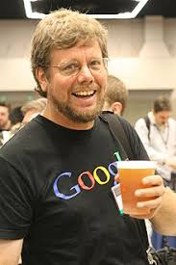
Who created Python ?
Developed by Guido van Rossum , a Dutch scientist
Created at Center For Mathematics and Research , Netherland
It is inspired by another programming language called ABC

Slide 8
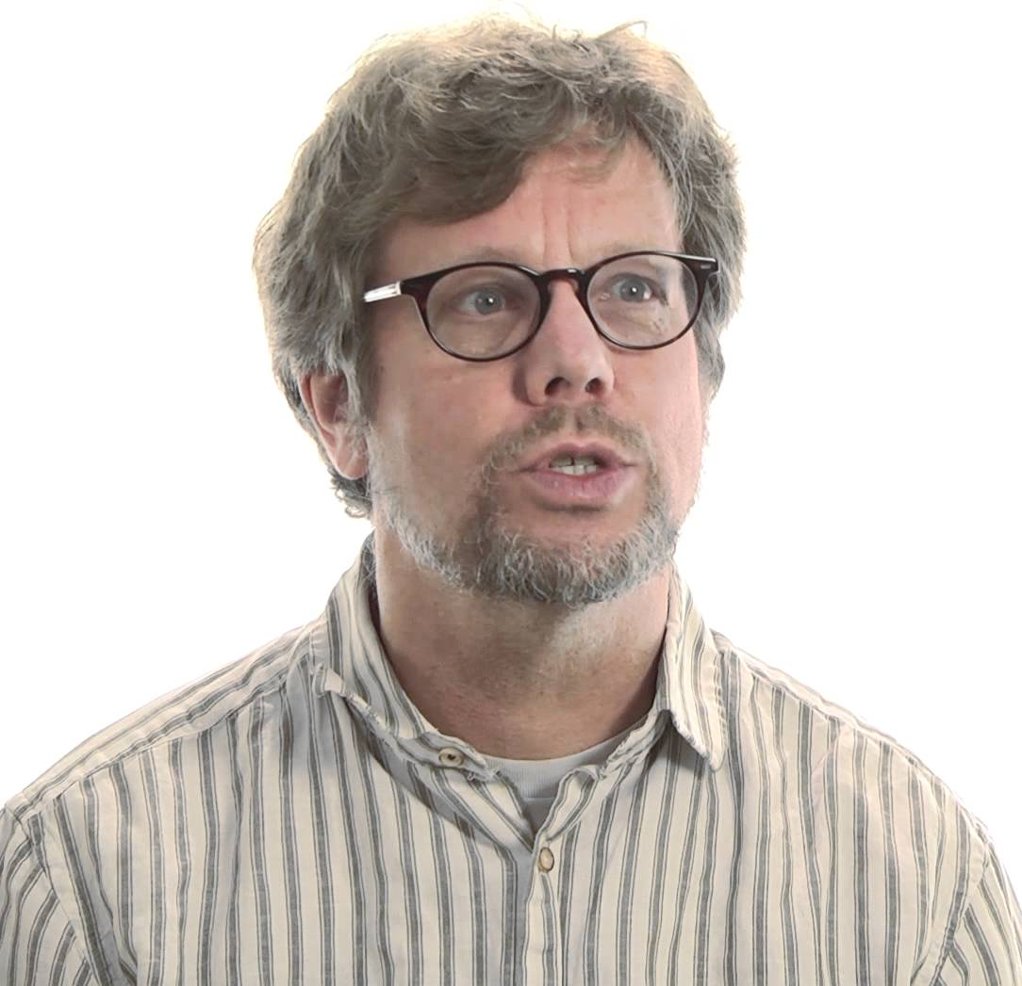
Why was Python created ?
Guido started Python development as a hobby in 1989
But since then it has grown to become one of the most polished languages of the computing world.

Slide 9

How Python got it’s name?
The name Python is inspired from Guido’s favorite Comedy TV show called “Monty Python’s Flying Circus”
Guido wanted a name that was short, unique, and slightly mysterious, so he decided to call the language Python.

Slide 10
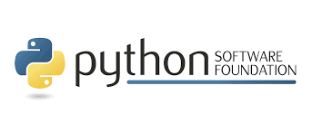
Who manages Python today ?
From version 2.1 onwards , python is managed by Python Software Foundation situated in Delaware , USA
It is a non-profit organization devoted to the growth and enhancement of Python language
Their website is http://www.python.org

Slide 11
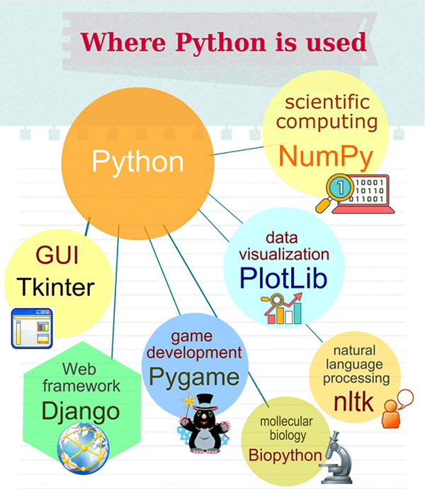
What Python can do ?
GUI Application
Web Application
Data Analysis
Machine Learning
Raspberry Pi
Game Development

Slide 12
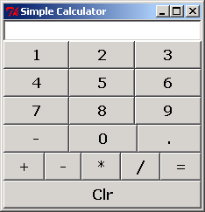
GUI In Python
Python is used for GUI apps all the time.
It has famous libraries like PyQT , Tkinter to build desktop apps.

Slide 13
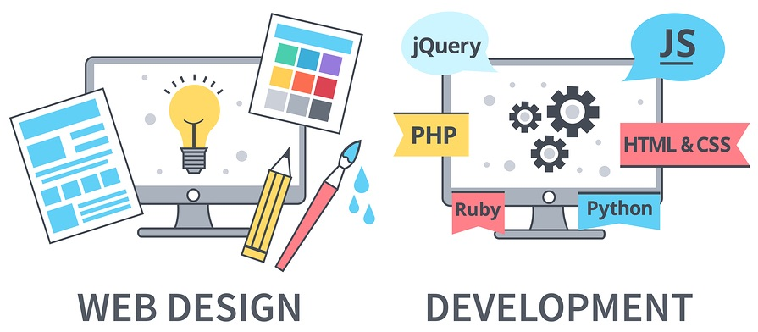
Web Application in Python
We can use Python to create web applications on many levels of complexity
There are many excellent Python frameworks like Django, FastAPI and Flask for this purpose

Slide 14
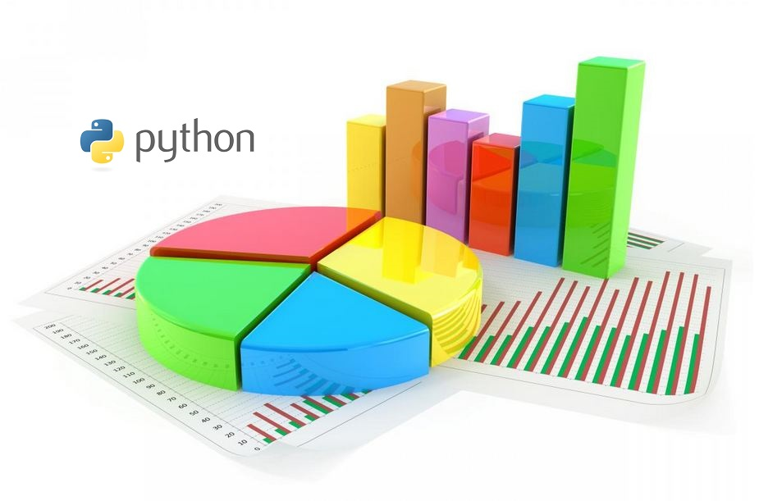
Data Analysis In Python
Data Analysis is about making predictions with data
Python is the leading language of choice for many data scientists
It has grown in popularity due to it’s excellent libraries like NumPy , Pandas etc.

Slide 15
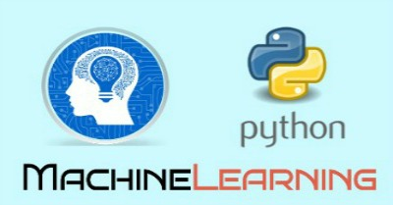
Machine Learning In Python
Machine learning is a field of AI (Artificial Intelligence) by using which software applications can learn to increase their accuracy for the expecting outcomes.
It is heavily used in Face recognition , music recommendation , medical data etc.
Python has many wonderful libraries to implement ML algos like SciKit-Learn , Tensorflow etc.

Slide 16
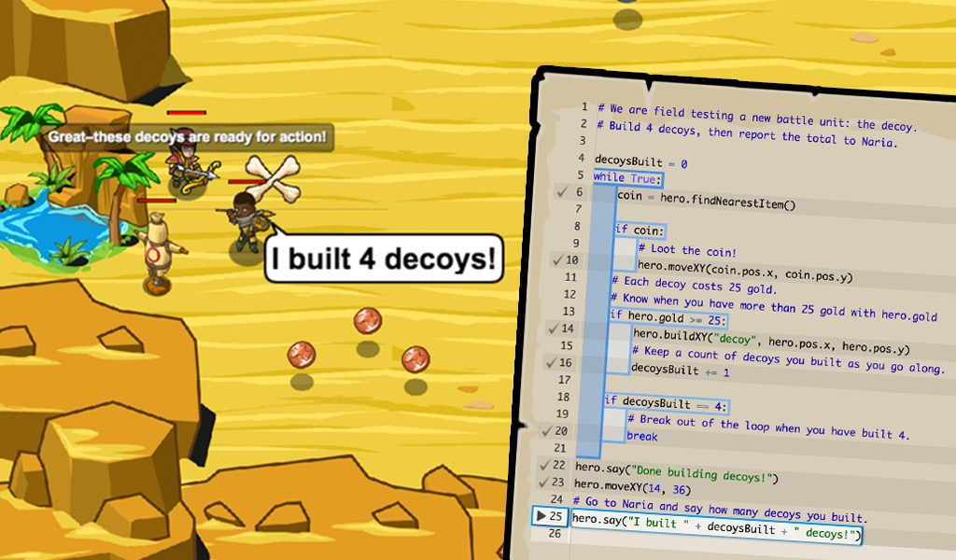
Game Development In Python
We can write whole games in Python using PyGame.
Popular games developed in Python are:
Bridge Commander
Civilization IV
Battlefield 2
Eve Online
Freedom Force

Slide 17
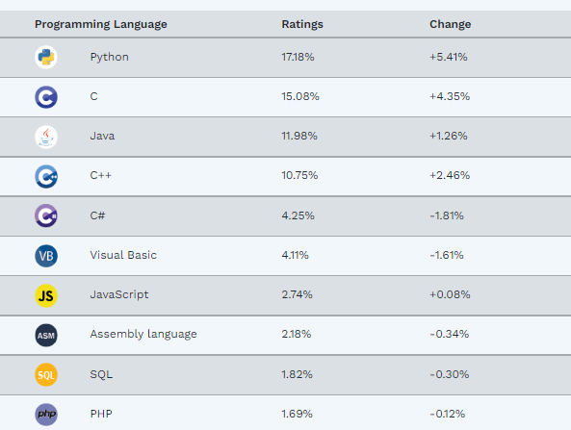
Why should I learn Python ?
TIOBE Index 2022
Most popular programming
Opens lots of doors
Big corporates prefer Python
Means , PYTHON IS THE FUTURE

Slide 18
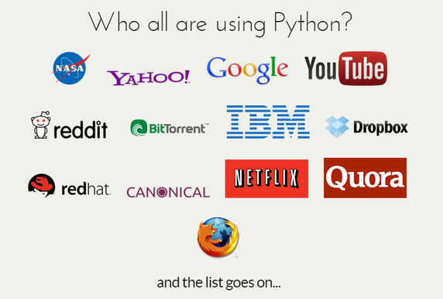
Who uses Python today ?

Slide 19
Features Of Python
Simple
Dynamically Typed
Robust
Supports multiple programming paradigms
Compiled as well as Interpreted
Cross Platform
Extensible
Embedded
Extensive Library

Slide 20
Simple
Python is very simple
As compared to other popular languages like Java and C++, it is easier to code in Python.
Python code is comparitively 3 to 5 times smaller than C/C++/Java code

Slide 21
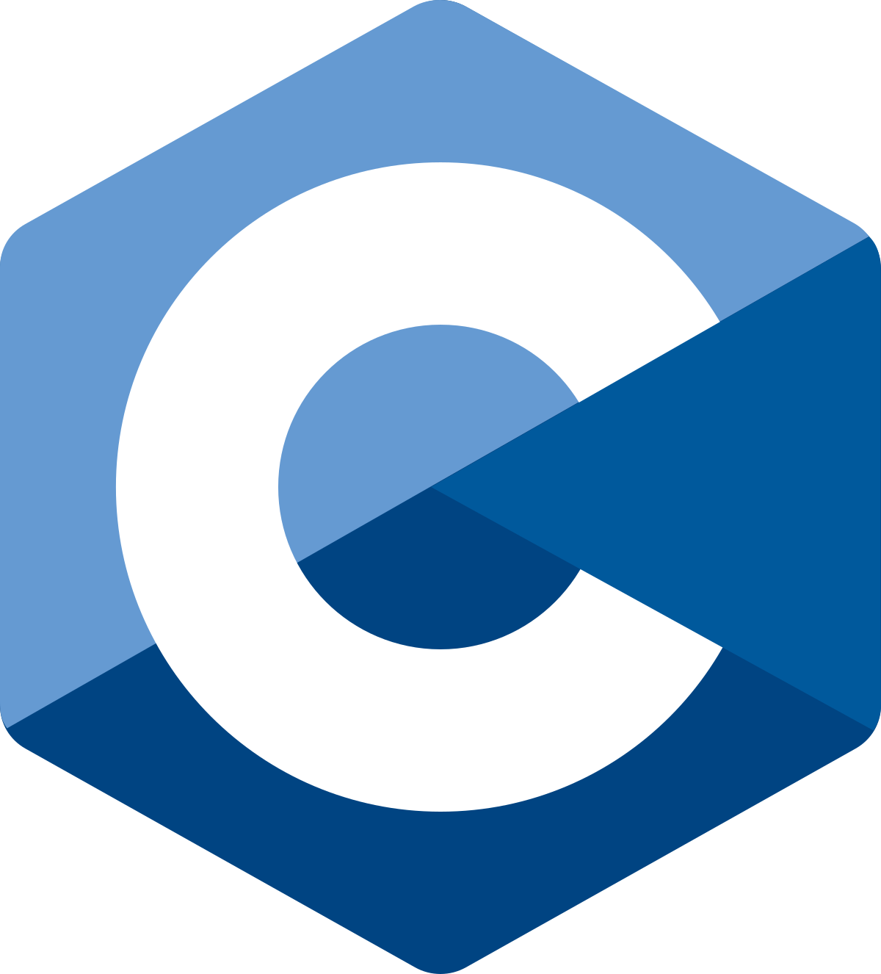
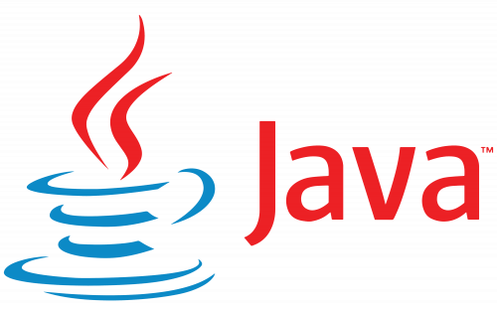
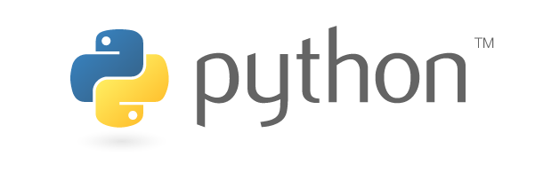
Print Hello World!
IN C
#include <stdio.h>
int main(){
printf("Hello World!");
return 0;
}
IN JAVA
public class HelloWorld{
public static void main( String[] args) {
System.out.println( "Hello World!" );
}
}
IN PYTHON
print('Hello World!')

Slide 22

Swap 2 Nos
IN C
int a=10,b=20,temp;
temp=a;
a=b;
b=temp;
IN JAVA
int a=10,b=20,temp;
temp=a;
a=b;
b=temp;
IN PYTHON
a,b=10,20
a,b=b,a

Slide 23
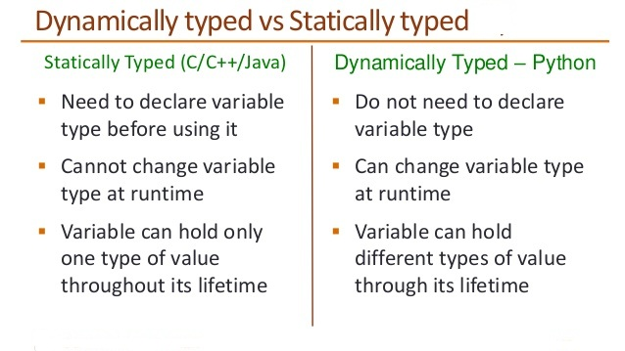
Dynamically Typed

Slide 24
Dynamically Typed
IN C
int a;
a=10;
a=“World”;
IN Python
a=10
a=“World”

Slide 25
Robust
Python has very strict rules which every program must
compulsorily follow and if these rules are violated then Python terminates the code by generating “Exception”
To understand python’s robustness , guess the output of the
following /C++ code:
int arr[5];
int i;
for(i=0;i<=9;i++)
{
arr[i]=i+1;
}

Slide 26
Python exceptions
In Python if we write the same code then it will generate Exception terminating the code
Due to this other running programs on the computer do not get affected and the system remains safe and secure

Slide 27
Supports Multiple Programming Paradigms
Python supports both procedure-oriented and object-oriented programming which is one of the key python features.
In procedure-oriented languages, the program is built around procedures or functions which are nothing but reusable pieces of programs.
In object-oriented languages, the program is built around objects which combine data and functionality

Slide 28
Compiled As Well As Interpreted
Python uses both a compiler as well as interpreter for converting our source and running it
However , the compilation part is hidden from the programmer ,so mostly people say it is an interpreted language

Slide 29
Cross Platform
Let’s assume we’ve written a Python code for our Windows machine.
Now, if we want to run it on a Mac, we don’t need to make changes to it for the same.
In other words, we can take one code and run it on any machine, there is no need to write different code for different machines.
This makes Python a cross platform language

Slide 30
Extensible
Python allows us to call C/C++/Java code from a Python code and thus we say it is an extensible language
We generally use this feature when we need a critical piece of code to run very fast .
So we can code that part of our program in C or C++ and then use it from our Python program.

Slide 31
Embedded
We just saw that we can put code in other languages in our Python source code.
However, it is also possible to put our Python code in a source code in a different language like C++.
This allows us to integrate Python feature into our program of the other language.

Slide 32
Extensive Library
The Python Standard Library is huge indeed.
It can help you do various things like Database Programming , E-mailing ,GUI Programming etc

Slide 33
Thank you

